Slide 1
Week 1
An Introduction to Cyber Security – CS 573
Instructor: Dr. Edward G. Amoroso
eamoroso@tag-cyber.com

Slide 2
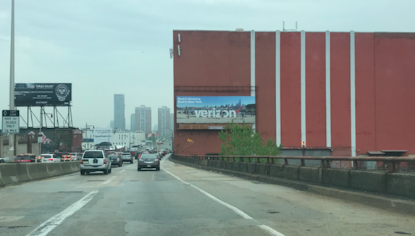
Week 1

Slide 3
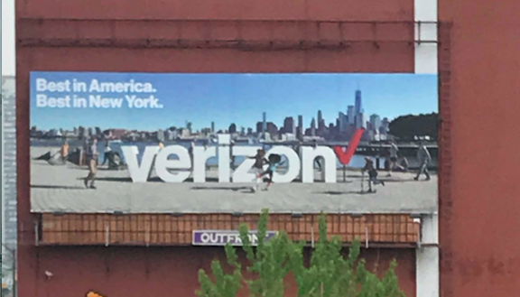
Week 1

Slide 4
Week 1

Slide 5
Week 1

Slide 6
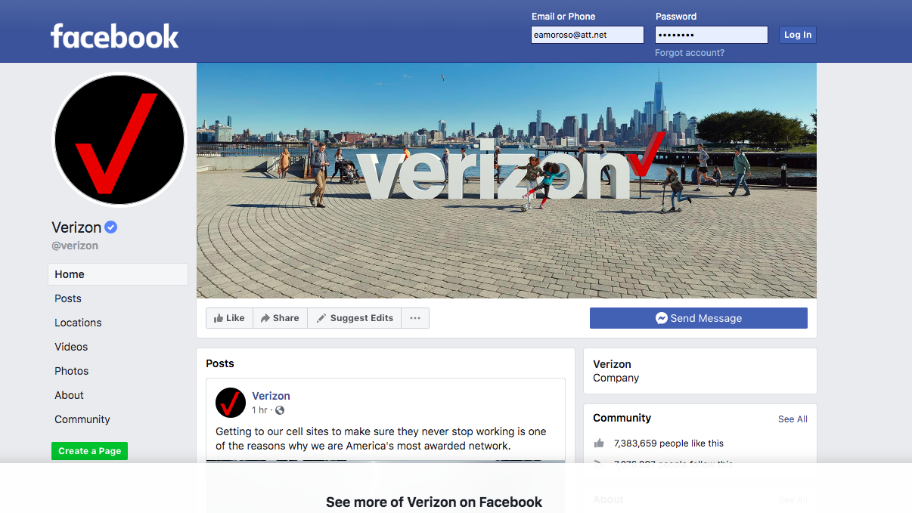
Week 1

Slide 7
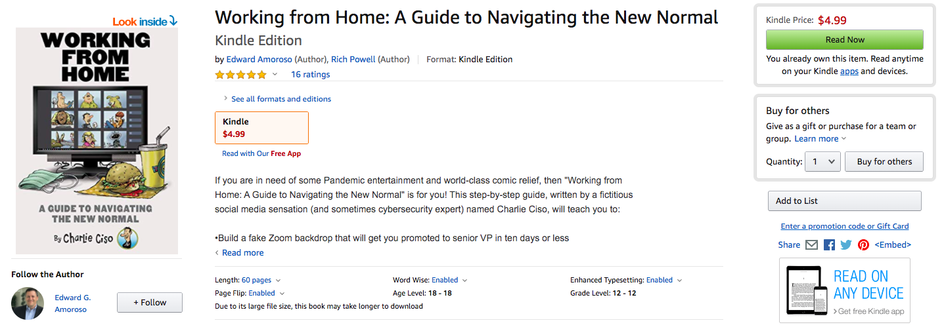
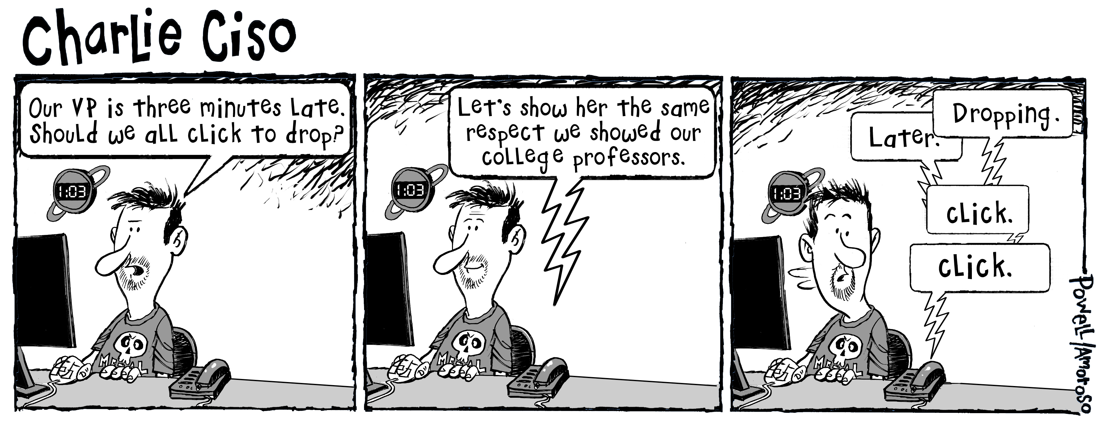
Week 1

Slide 8
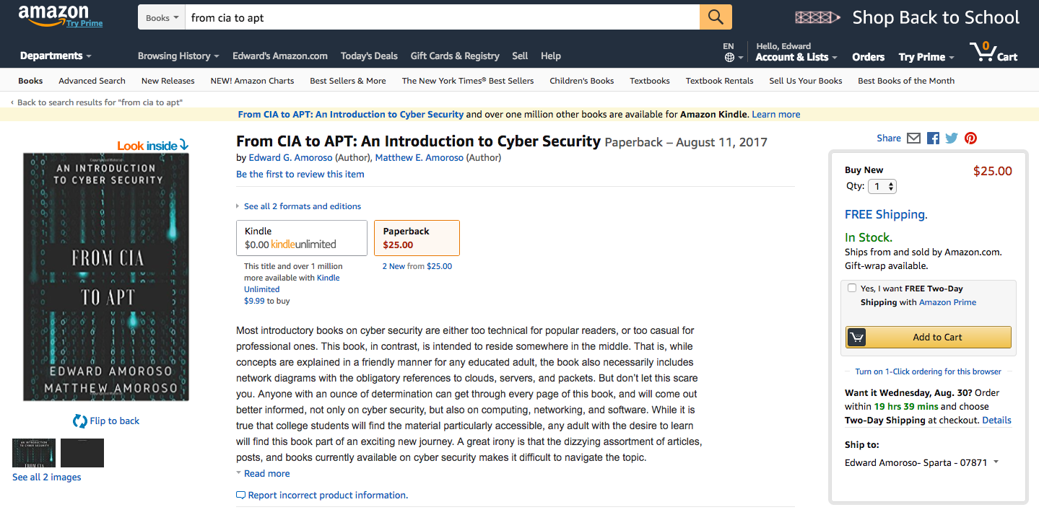
Required Text – $9.99 Download from Amazon.com
$25.00 Printed Paperback Book from Amazon.com
From CIA to APT: An Introduction to Cyber Security
Edward G. Amoroso & Matthew E. Amoroso
Week 1

Slide 9
Week 1
Required Week One Readings
1. “Reflections on Trusting Trust,” Ken Thompson
https://www.ece.cmu.edu/~ganger/712.fall02/papers/p761-thompson.pdf
2. Chapters 1 through 4: From CIA to APT: An Introduction
to Cyber Security, E. Amoroso & M. Amoroso
Twitter: @hashtag_cyber
LinkedIn: Edward Amoroso

Slide 10
Week 1: Introduction to Cyber Security Issues
Week 1

Slide 11
Week 1

Slide 12
Week 1

Slide 13
Week 1

Slide 14
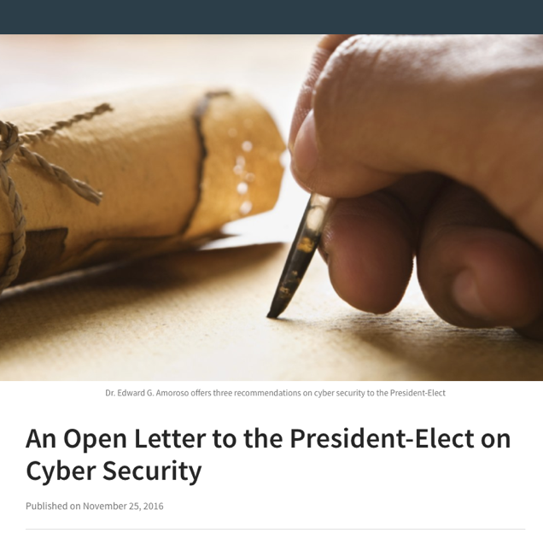
D.J. Trump
President of the United States
White House
Washington, DC
Sir:
1. Direct that the NIST Framework shall be the only acceptable cyber security compliance standard in the United States.
2. Direct that each government agency shall immediately implement a plan to reduce their dependence on an enterprise perimeter.
3. Direct that each government agency shall significantly expand their Cyber Corps Program for young people interested in a cyber security career.
Yours very truly,
Dr. Edward Amoroso
Week 1

Slide 15
Cyber Security: Attack Lifecycle (Defense View)
Week 1
Indications and Warning Phase
Incident Response Phase
Pre-Attack
Indicators + Normal
Response Actions
r1
r2
r3
r4
r5
r6
a1
a2
a3
a4
a5
a6
a7
a8
a9
Observed Attack +
Normal Actions
Threshold
(Policy Violated)
Pre-Consequence
Post-Consequence

Slide 16
Cyber Security: Attack Lifecycle (Defense View)
Week 1
Indications and Warning Phase
Incident Response Phase
Pre-Attack
Indicators + Normal
r5, r6 Designed
to Stop Future Attack
Response Actions
r1
r2
r3
r4
r5
r6
a1
a2
a3
a4
a5
a6
a7
a8
a9
Observed Attack +
Normal Actions
Threshold
(Policy Violated)
r1, r2 Slow
Progress of Attack
r1, r2, r3, r4 Stop
Progress of Attack
Pre-Consequence
Post-Consequence

Slide 17
Advanced Persistent Threat (APT) Global Actors
Week 1
challengers
leaders
Russia
USA
1. USA, Russia, China, Israel, and
the UK have ~ 100% success rates
on offensive APT cyber operations
2. North Korea derives ~100% of
its APT cyber operations capability
via training and support from China
3. Romania, Iran, and Ukraine have
large populations of technically
trained, under-employed youth
China
Romania
UK
Israel
Iran
ability to execute
Ukraine
N. Korea
India
France
Brazil
niche players
visionaries
completeness of vision

Slide 18
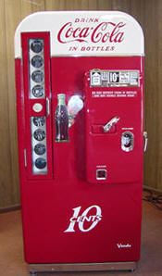
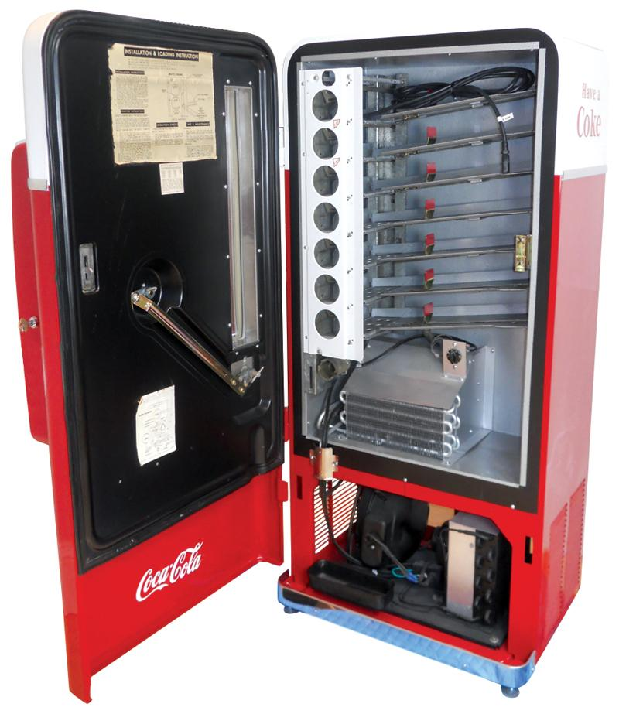
Understanding the Hack: 70’s Vintage Soda Machine
Week 1

Slide 19
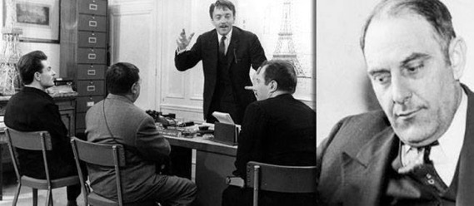
Understanding the Hack: Early Scams and Social Engineering
Week 1
Victor Lustig

Slide 20
Understanding the Hack: Unauthorized Infrastructure Access
Week 1
Kevin
Poulsen

Slide 21
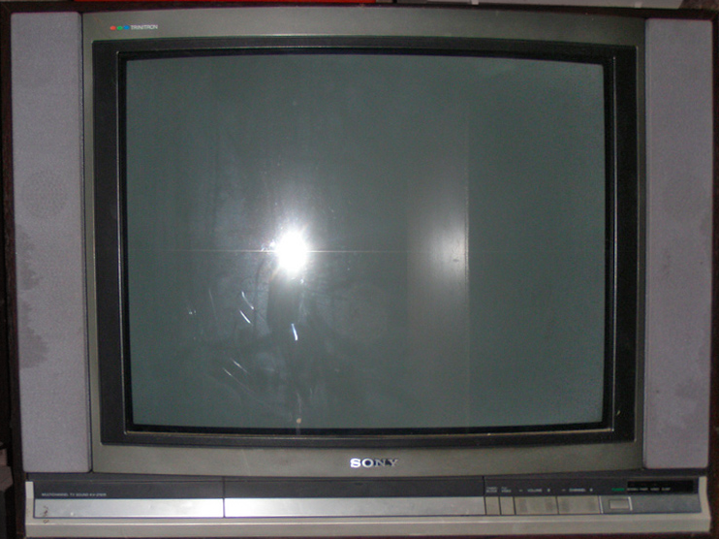
Week 1
Scrambled Picture for Non-Payers

Slide 22
Week 1
Continental Cablevision of Hartford broadcast a special offer of a free T-shirt during last fall's Holyfield/Bowe fight (14 Nov 92). Unlike most pay-per-view broadcasting, this one did not show up through legitimate decoders. The ad and its 800 number only showed up when watched through illegal decoders. 140 freeloaders called the 800 number within minutes of the ad’s broadcast. Continental sent the T-shirts by certified, return receipt mail, and then sent them a follow-up letter reminding them of the federal law (fines up to $10,000) and demanding a $2000 fine.
[Chicago Tribune, 3 Feb 1993]

Slide 23
Week 1
To receive your free tee-shirt, please contact us at
Fake Enticement for Fraudsters

Slide 24
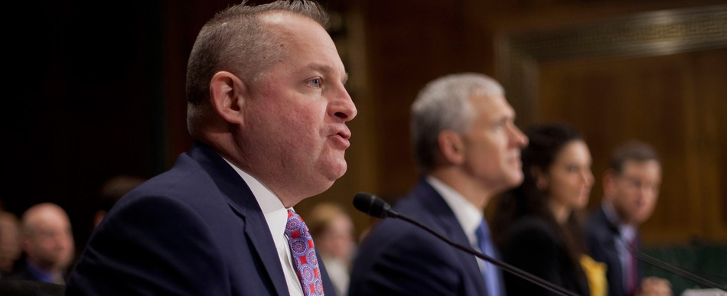
Jan 2014
40 Million Credit Cards Stolen from Target
Hacked third-party vendor access unnoticed from 12/2/13 to 1/16/14
CEO and CIO of Target apologized and resigned
Remediation/legal costs: $162M (Target) and $200M (Banks)

Slide 25

May 2014
145 Million eBay Users Hacked
Compromised name, encrypted password, email, home address, etc.
Companywide password reset function was used in the attack.
“The focus is on recovery,” CEO John Donahoe.

Slide 26
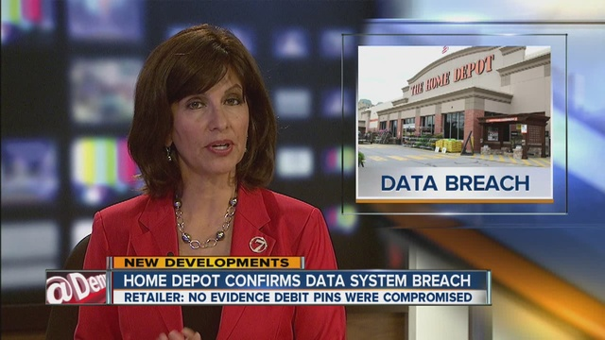
Sept 2014
Five Month Undetected Attack at Home Depot
Compromised 56 million customer payment cards
CEO apologized publicly after the cyber attack
Famous security budget retort from ex-employee: “We sell hammers.”

Slide 27
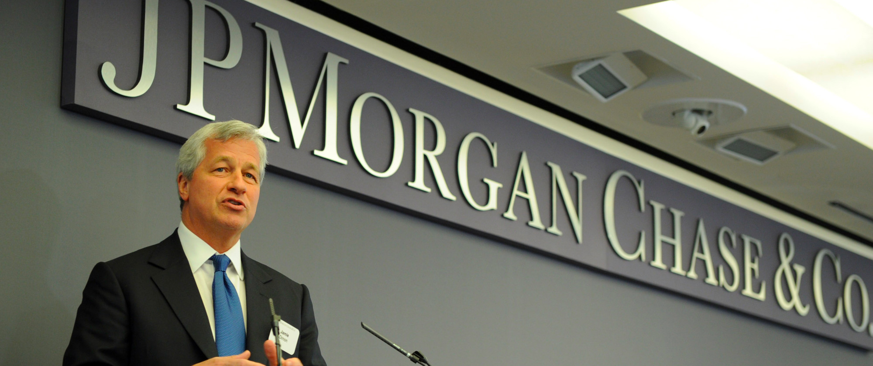
Sept 2014
76 Million Households Hit by JPMC Breach
Customer contact information – name, email, address, and phone
2014 attack blamed on Russian hackers by FBI
CEO Jamie Dimon claims increasing JPMC Cyber Security budget to $250M

Slide 28
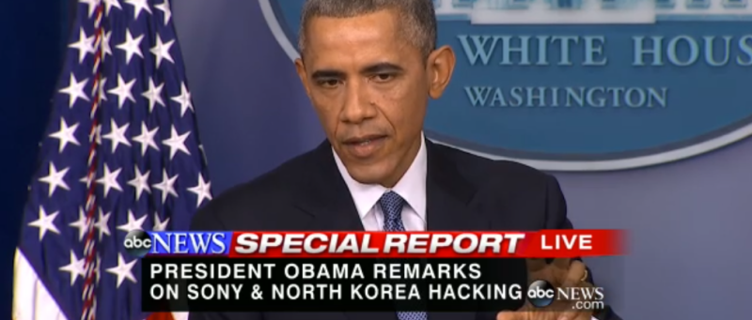
Nov 2014
Sony Destructively Hacked by North Korea
Destructive malware attack ruined Sony compute infrastructure
Revealed corporate emails including racist remarks about Pres. Obama
“It was an attack on our freedom of expression.” DHS Secretary Johnson

Slide 29
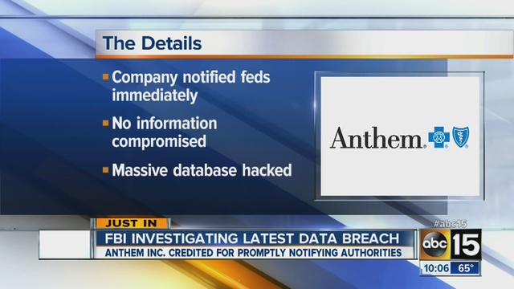
Feb 2015
80 Million Medical Records Stolen from Anthem
Two month process to notify astonished customers
Abnormal system behavior went unnoticed for several months
“I want to personally apologize to each of you.” Joseph Swedish, CEO

Slide 30
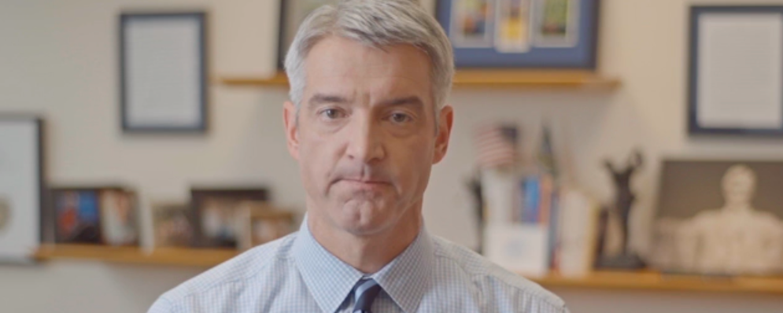
Mar 2015
11 Million Premera Customer Insurance Records
Thirty-eight class action law suits based on 2015 attack
Name, birthdate, SSN, address, bank account info, claim info, etc.
“Privacy of our members’ personal information remains a priority.”

Slide 31
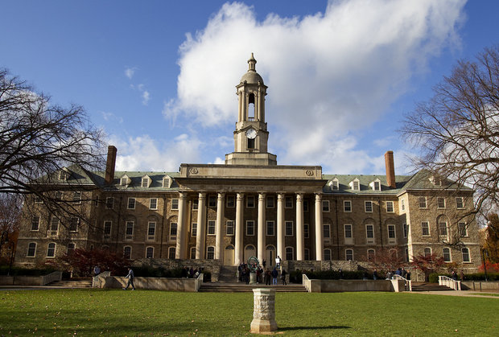
May 2015
Hackers Nab Data on 18,000 Penn State Students
Started in September 2012, continued through mid-2014
University claims attack carried out by Chinese threat actor
CISO being recruited ($300K- $700K) – Avg. Public College Pres. ($428K)

Slide 32
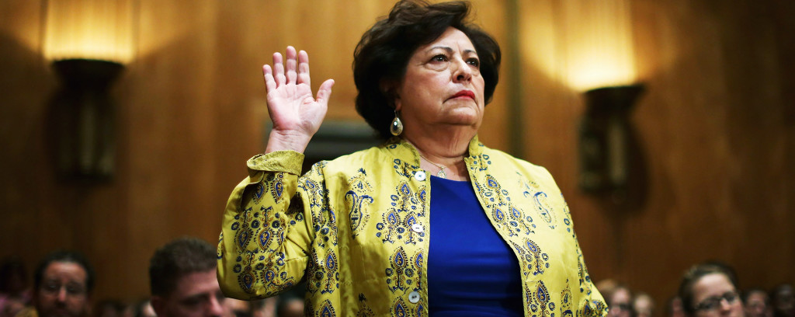
June 2015
Sixteen Month Undetected OPM Breach
Background and thumbprints for 15% of the US workforce
Director Katherine Archuleta resigned 7/15
Military group from PRC most likely malicious actor

Slide 33
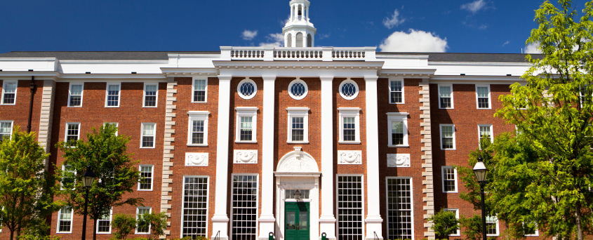
June 2015
Hackers Breach Harvard University Credentials
Involved eight colleges (Arts & Sciences, Divinity, Radcliffe, etc.)
University has no clear understanding of what happened or how
FAQ suggests that everyone change their passwords

Slide 34
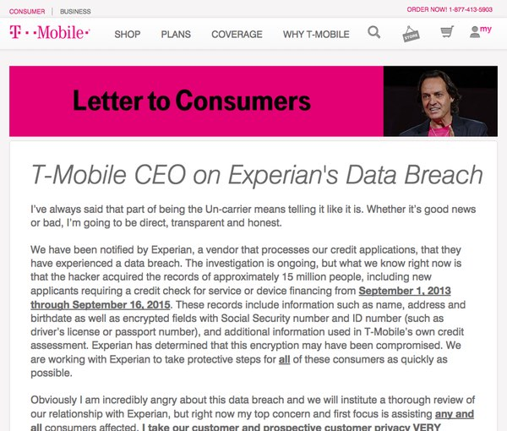
Oct 2015
15 Million T-Mobile Records via Experian Breach
Experian providing third-party marketing services to T-Mobile
Name, address, SSN, birth date, passport/driver’s license, etc.
“T-Mobile’s Legere ‘Incredibly Angry’ about Breach” – News Reports

Slide 35
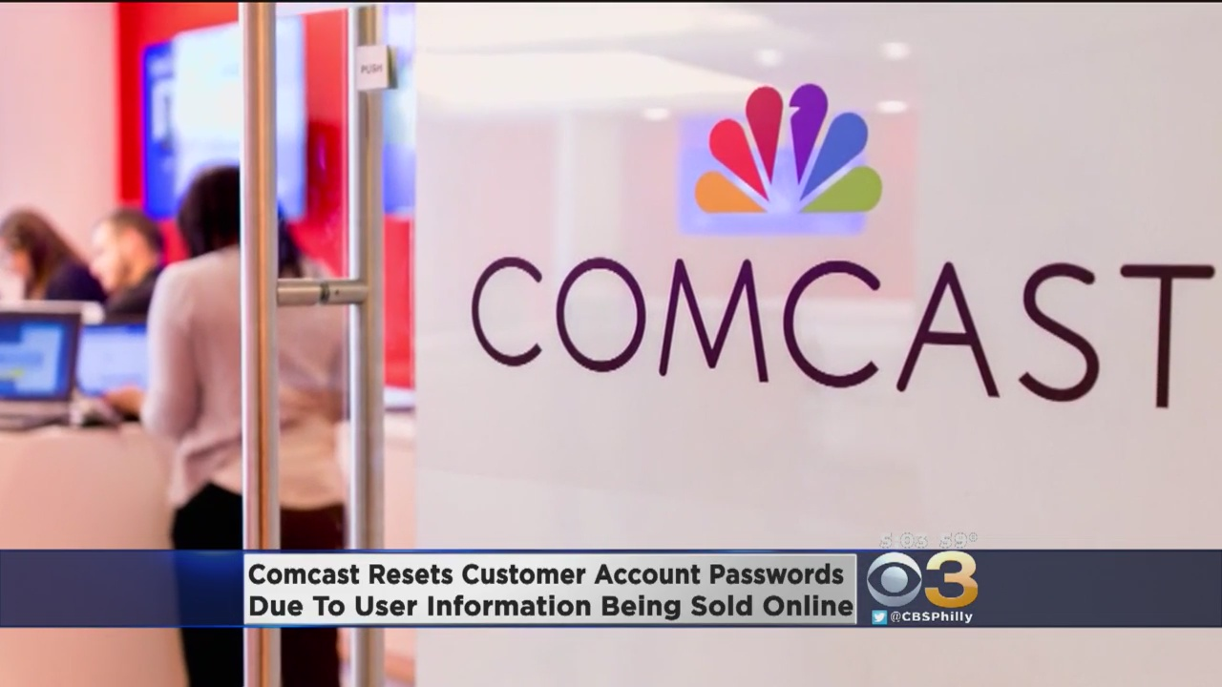
Nov 2015
200,000 Comcast Customer Records Exposed
Company reported 200,000 customer records “exposed to hackers”
590,000 customer records for sale on Dark Web for $1,000.00
Company requested that customers change their passwords

Slide 36
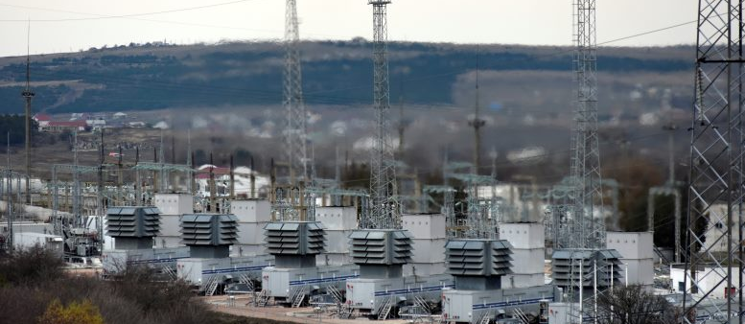
Dec 2015
Plant supporting Stroganovka,
outside Simferopol, Crimea
Hackers Shut Power to 80,000 Ukrainian Citizens
Hacked Power Company 1: Prykarpattyaoblenergo Electric Utility
Hacked Power Company 2: Kyivoblenergo Electric Utility
Affected Six More Companies with BlackEnergy Trojan Horse

Slide 37
Jan 2016
191 Million US Voter Records Compromised
NationBuilder collects information and provides as-a-service
“We strongly believe in making voter information more accessible to political campaigns and advocacy groups,” NationBuilder's CEO Jim Gilliam

Slide 38
Mar 2016
Hackers Sell 1.5 Million Customer Records
1.5 million Verizon customer records stolen from the company
Sale price: $100,000 for the entire package on the Dark Web
Verizon blamed an exploitable flaw in their Website

Slide 39
Apr 2016
1,025 Wendy’s Stores Hit by Credit Card Breach
Blamed on unnamed third-party with access to company
Company hit with class action lawsuit after the breach
Initial statement under-estimated impact by the company initially

Slide 40
May 2016
427 Million Stolen MySpace Passwords
Hacker selling batch for $2800 payment
Hacker also claims to have data on 164M LinkedIn Accounts
Danger: Do not reuse passwords across accounts

Slide 41
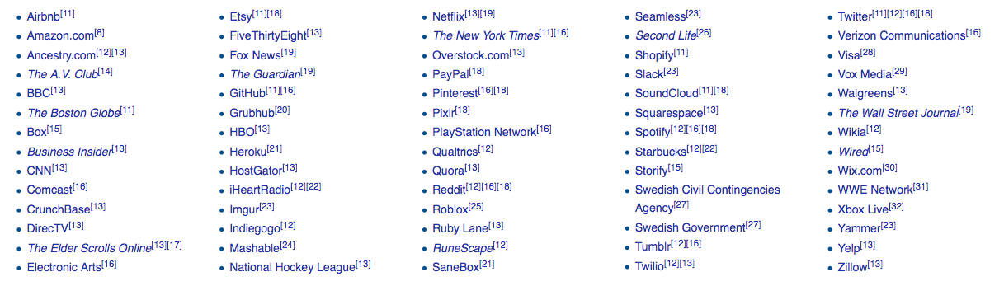
Oct 2016
DYN DDOS Attack
Massive DDOS attack (possibly by Anonymous)
Caused outages across major North American services
Botnet: Cameras, gateways, baby monitor, and other IoT devices

Slide 42
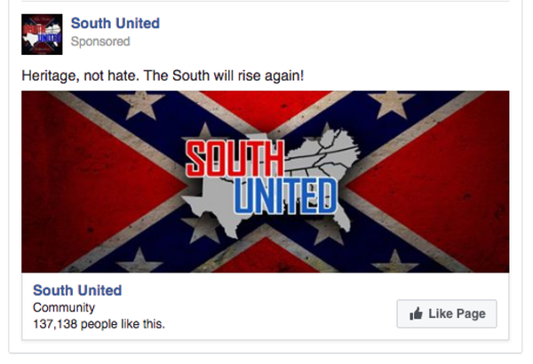
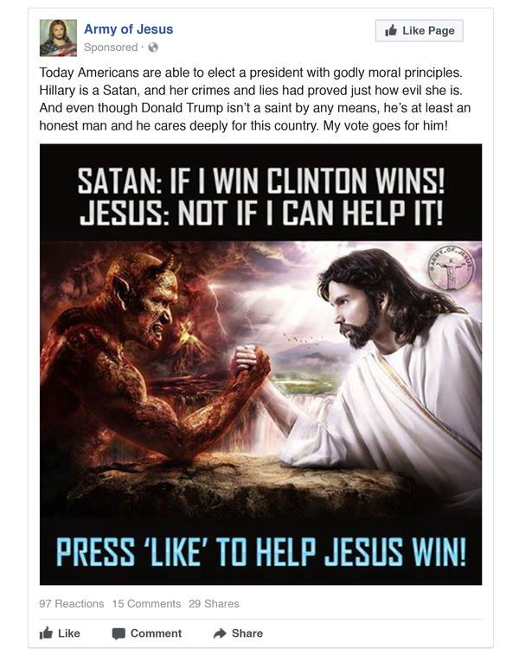
Nov 2016
US Election “Information” Attacks
Difference between “cyber superiority” and “information superiority”
American Intelligence Community concludes Russian origin
Social media manipulated using poorly monitored features

Slide 43
May 2017
WannaCry Ransomware Attack
Hits 300,000 targets including National Institute of Health (NIH)
Spread via worm using tools stolen from NSA
Suggests weak disaster planning across most global business

Slide 44
July 2017
Equifax Breach Affects 143M US Citizens
Vulnerabilities unpatched in Apache Struts in Equifax portal
First vulnerability reported weeks before attack commenced
Hackers created 39 undetected back doors into Equifax

Slide 45
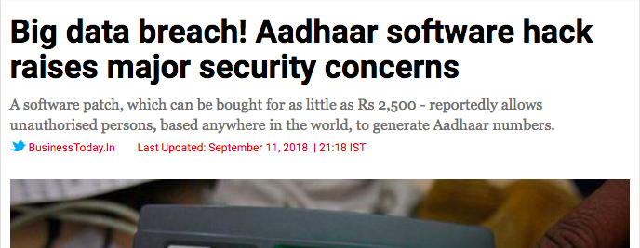
Aug 2017
Aadhaar Exposes 1.1B Citizens of India
Breach exposed Aadhaar number, names, emails, and physical addresses.
Also breached phone numbers and photos.
Break-in to India’s Unique Identification Authority (records of all citizens)

Slide 46
Nov 2017
Hackers Breach Personal Data for 45M Uber Riders
Attack occurred in 2016 (GitHub account), but reported in 2017
Hackers demanded $100K for data and Uber paid the fee
Cover-up causing considerable litigation on-going

Slide 47
June 2018
Exactis Exposes Data for 340M US Citizens
Marketing firm had hacked data included name, address, email, etc.
Security researcher noticed database openly accessible (via Shodan)
Massive implications for citizen privacy

Slide 48
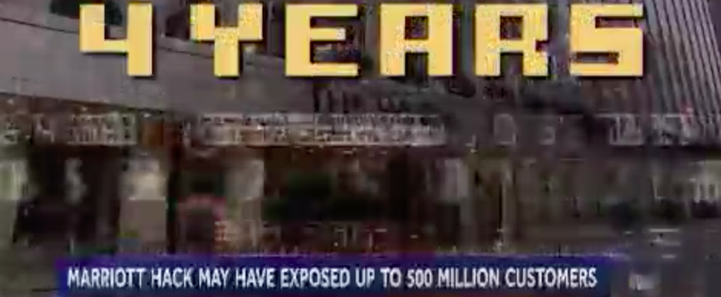
Dec 2018
Starwood/Marriott Exposes Data for 500M Guests
Breach exposed names, email addresses, and physical addresses.
Also phone numbers, passport numbers, and account info.
Also birth dates, gender, travel info, and accommodation info.
Second Largest Breach Ever. (After Yahoo)

Slide 49
Jul 2019
CapitalOne Breach Affects 100M Accounts
Breach involved AWS misconfiguration
Affected 100 million individuals in the US and 6 million in Canada
Credit card and social security number information

Slide 50
Jul 2020
Twitter Account Takeover (ATO) Breach
Too many team members had access to account information
Fake Tweets sent out from prominent accounts (e.g., politicians, etc.)
Some bitcoin sent to two twenty-somethings (Florida and Canada)

